Slide 1

“CHENA” Web based Agricultural Supply Chain Management System
ITE 3962 Final Year Project (24S1)
Presented by:
E2145273 - Rajapaksha L.S
Bachelor of Information Technology

Slide 2


Introduction
The solution is ,
Direct farmer to buyer marketplace
Integrated transport coordination
Secure online payments
Transparent pricing model
1

Slide 3

Motivation
Empower farmers with pricing control
Reduce dependency on intermediaries
Improve trust and transparency
Digitize agricultural trade
2

Slide 4

Problem Identification
Middlemen control agricultural pricing
Farmers earn low profits
Buyers pay higher prices
Lack of transparency
Poor logistics coordination
3

Slide 5
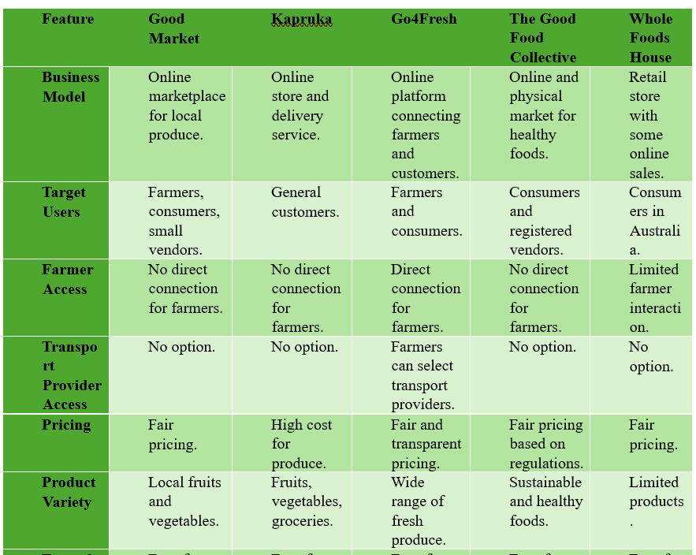
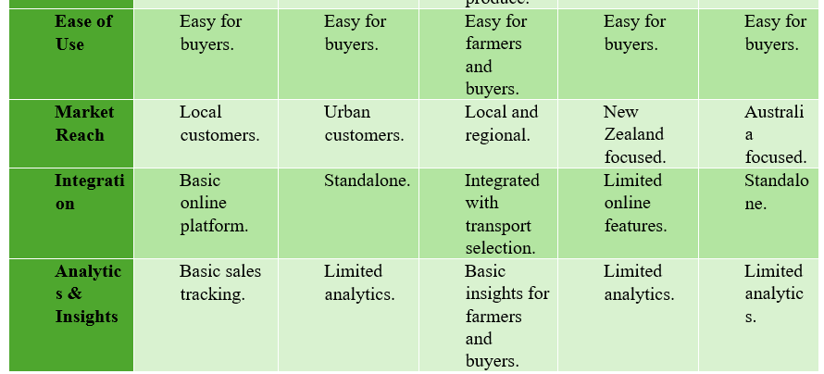

Existing solutions and alternatives
4

Slide 6


Proposed Solution
Chena web-based platform
Direct trade without middlemen
Integrated transport and payments
Role-based system access
5

Slide 7

Methodology
Agile development approach
Incremental feature delivery
Continuous testing and feedback
6

Slide 8
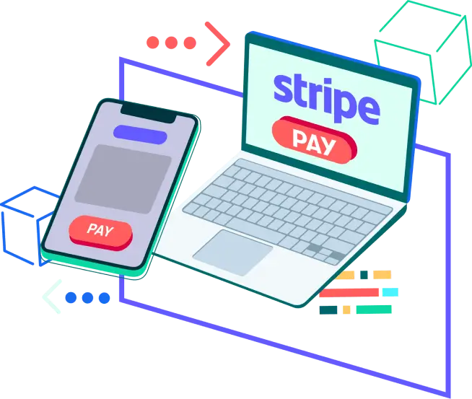

Technologies
Frontend: React.js
Backend: Node.js
Database: MySQL
Payment Gateway: Stripe
7

Slide 9

Key Features
User registration and role-based access for farmers, buyers, transport providers, and administrators
Farmer controlled product listing, pricing, and inventory management
Buyer friendly product browsing, searching, and order placement
Automatic stock validation and inventory updates during order processing
Integrated transport provider pricing and delivery management
Real-time order tracking and delivery status updates
Secure online payment processing using Stripe
Role-specific dashboards for efficient system interaction
Sales, income, and performance reporting for farmers and administrators
8

Slide 10
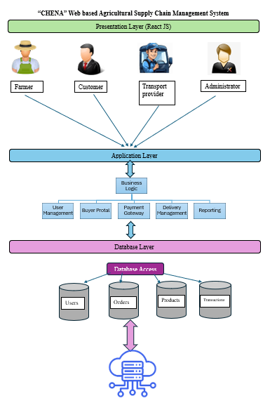
System Architecture
9

Slide 11
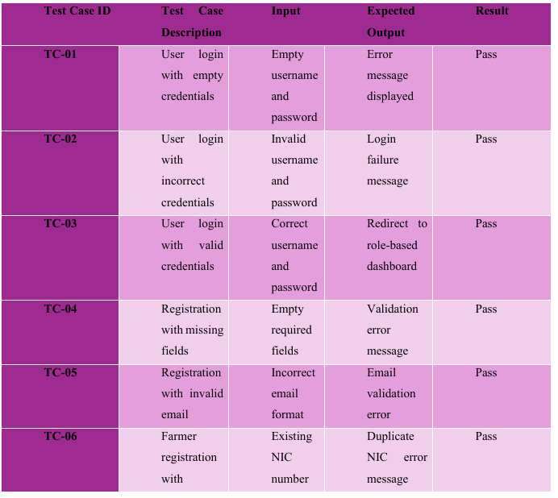
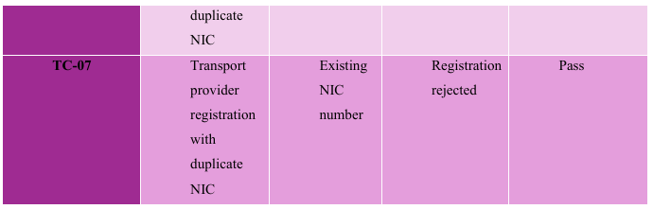
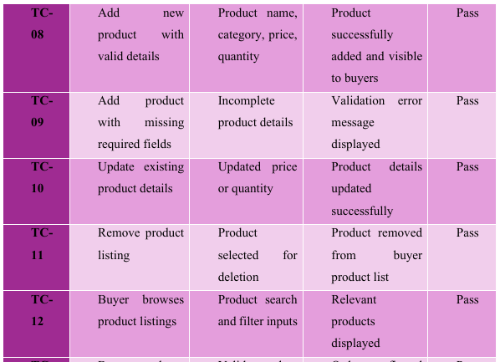
Test Results
10

Slide 12

Conclusion
Chena provides more complete supply chain coverage than existing systems
Enables direct farmer control, transparent pricing, and integrated logistics
Outperforms similar platforms by combining trade, transport, and payments
Current limitations include localhost deployment and limited analytics
Future work includes cloud hosting, mobile application support, and advanced reporting
11

Slide 13
Prototype Evaluation Recommendation from Evaluator
Adding phone number validation
Implementing Payment gateway
Implementing Admin Dashboard
12

